Slide 1
실습 02-DNS
휴먼지능정보공학과
201810760 김상경

Slide 2
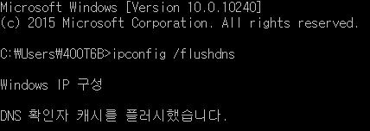
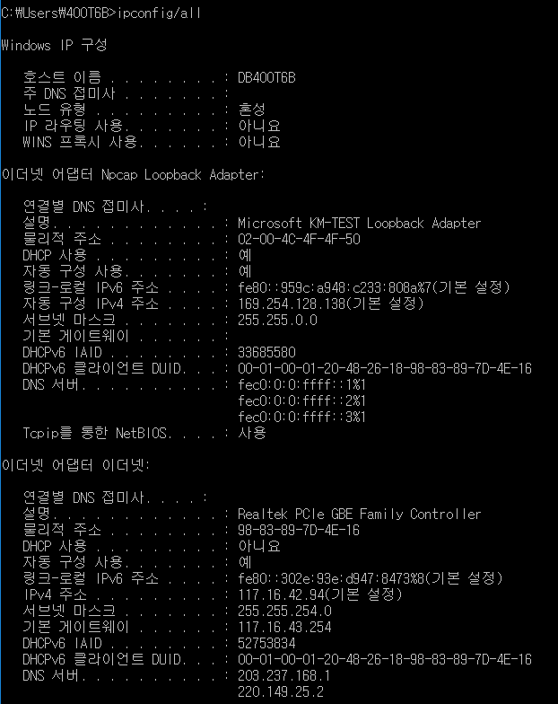
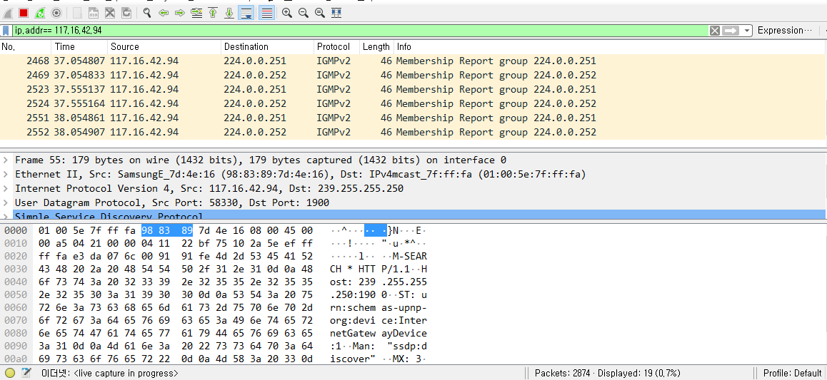
Lab 02-1: nslookup
1. Use ipconfig to empty the DNS cache in your host.
2. Open Wireshark and enter “ip.addr == your_IP_address” into the filter, where you obtain your_IP_address with ipconfig. This filter removes all packets that neither originate nor are destined to your host.

Slide 3
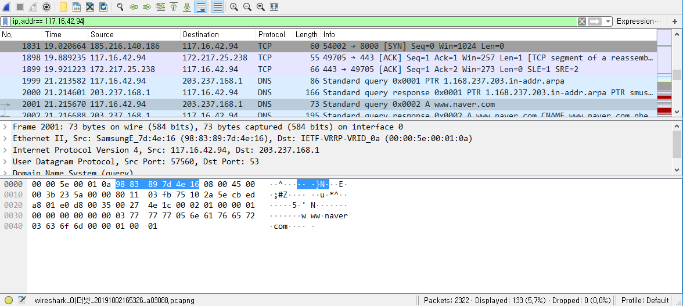
Lab 02-1: nslookup
3. Before running nslookup in step 4, start capture using Wireshark.

Slide 4
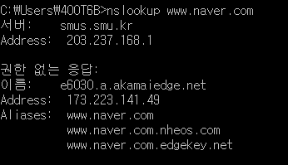
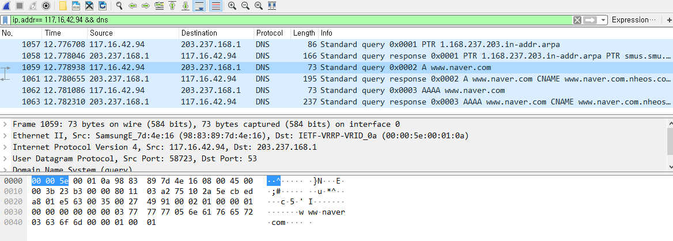
Lab 02-1: nslookup
4. Open a CMD window and Run “nslookup www.naver.com”
권한 없는 응답이란?
- 도메인에 해당하는 IP 주소를 미리 알고있는 다른 라우터가 IP주소 정보를 알려준 응답

Slide 5
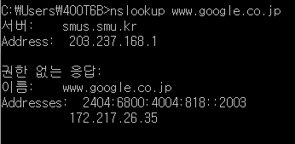
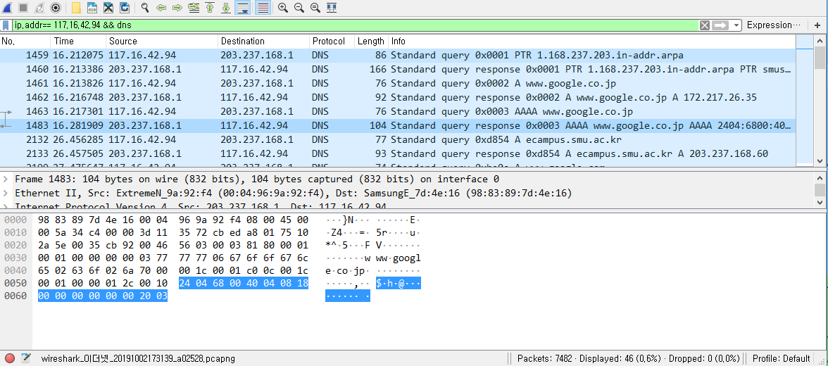
Lab 02-1: nslookup
5. Run nslookup to obtain the IP address of a Web server in Asia

Slide 6


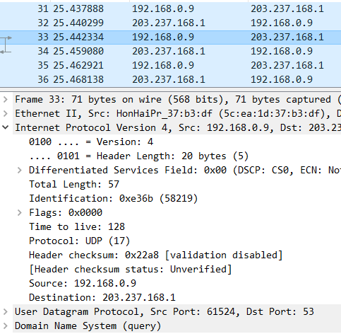
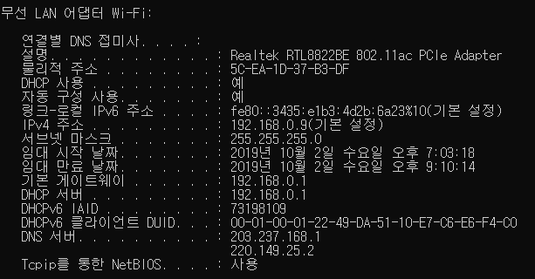
Lab 02-2: nslookup continued
1. What is the destination port for the DNS query message? What is the source port of DNS response message?
Query message
Response message
2. To what IP address is the DNS query message sent? Is this the IP address of your default local DNS server?
DNS query message 의 Destination은
203.237.168.1이고
DNS 서버의 IP address 또한 같기 때문에 query 메시지가 잘 전달 되었음을 볼 수 있었다.

Slide 7
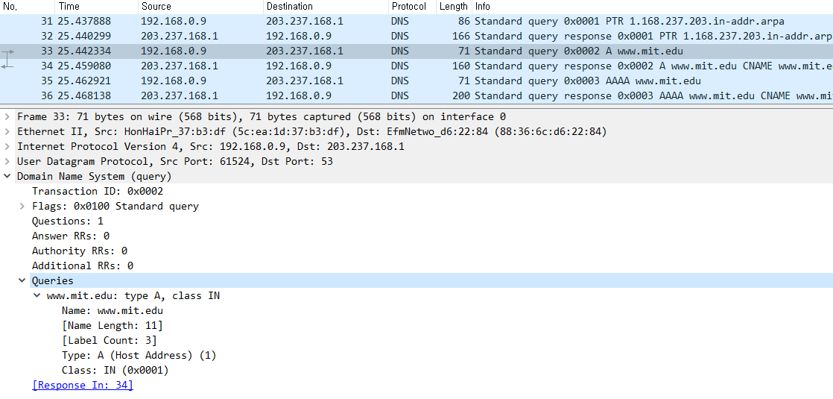
Lab 02-2: nslookup continued
3. Examine the DNS query message. What “Type” of DNS query is it? Does the query message contain any “answers”?
Type 은 A type이고, answer을 포함하고 있지 않다.

Slide 8
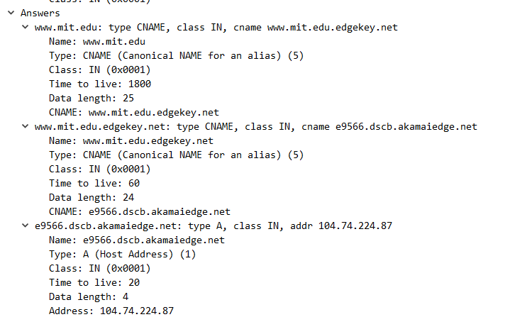
Lab 02-2: nslookup continued
4. Examine the DNS response message. How many “answers” are provided? What do each of these answers contain?
3 answers를 provide 한다.
Name | Type | Class | Time to live | Data Length
www.mit.edu | CNAME | IN | 1800 | 25 | CNAME : www.mit.edu.edgekey.net
www.mit.edu.edgekey.net | CNAME | IN | 60 | 24 | CNAME : www.mit.edu.edgekey.net
e9566.dscb.akamiedge.net | A | IN | 20 | 4 | Address : 104.74.224.87

Slide 9

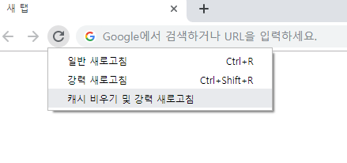
Lab 02-3: DNS
1. Use ipconfig to empty the DNS cache in your host.
2. Open your browser and empty your browser cache. (With Internet Explorer, go to Tools menu and select Internet Options; then in the General tab select Delete Files.)

Slide 10
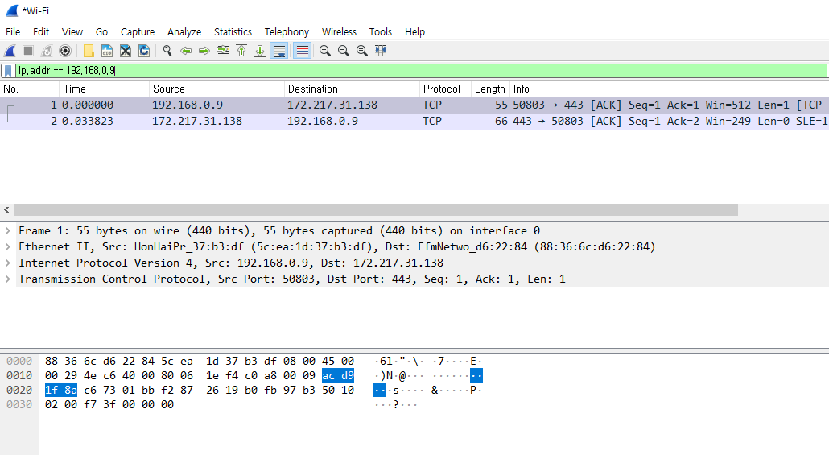
Lab 02-3: DNS
3. Open Wireshark and enter “ip.addr == your_IP_address” into the filter, where you obtain your_IP_address with ipconfig. This filter removes all packets that neither originate nor are destined to your host

Slide 11
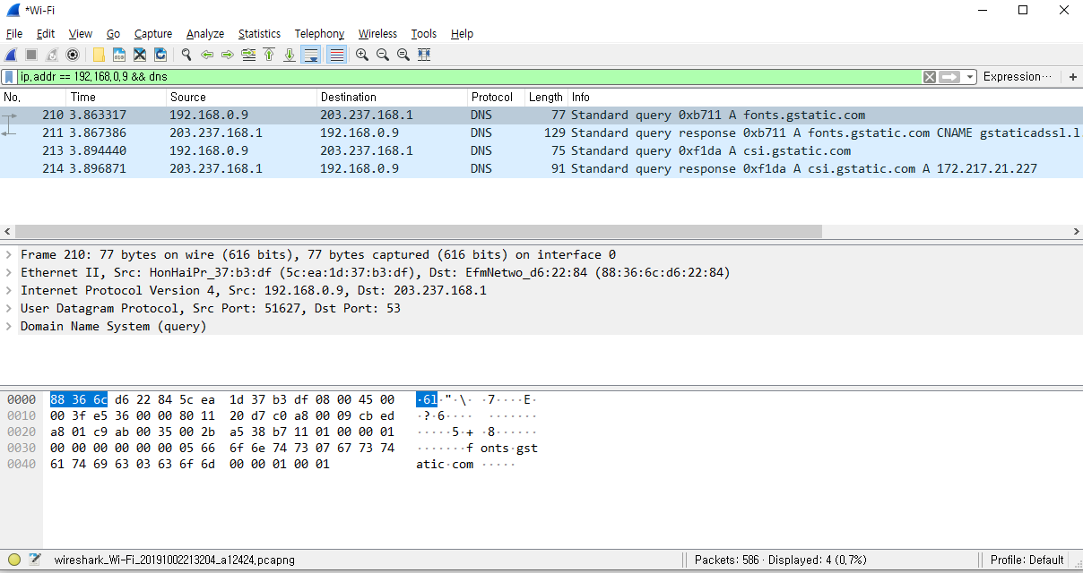
Lab 02-3: DNS
4. Start packet capture in Wireshark
5. With your browser, visit the Web page: http://www.ietf.org
6. Stop packet capture.

Slide 12
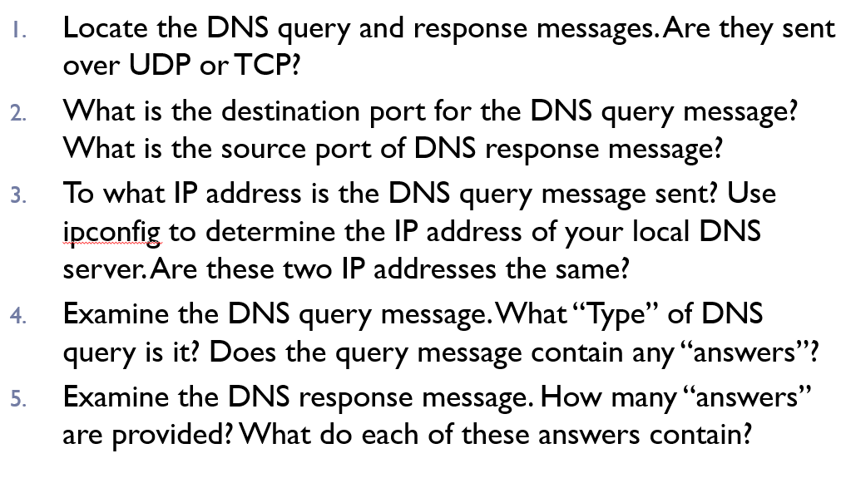
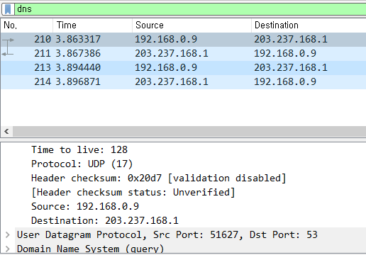
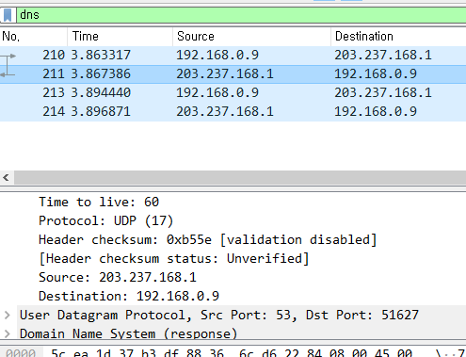
Lab 02-3: DNS

Slide 13
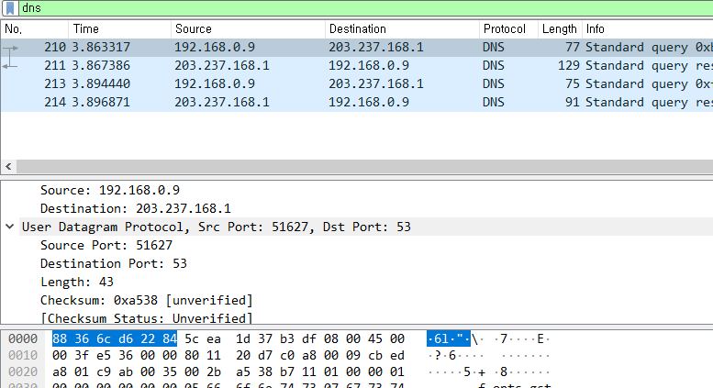
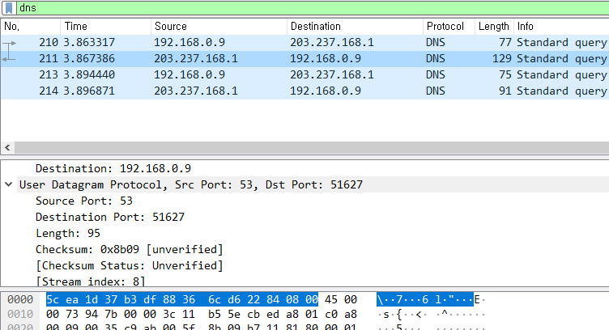
Lab 02-3: DNS

Slide 14
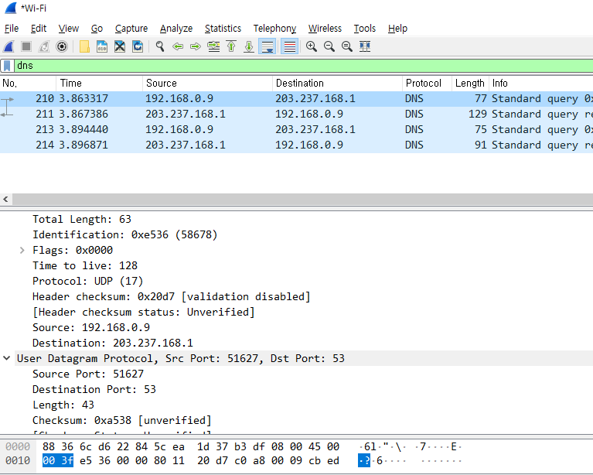
Lab 02-3: DNS

Slide 15
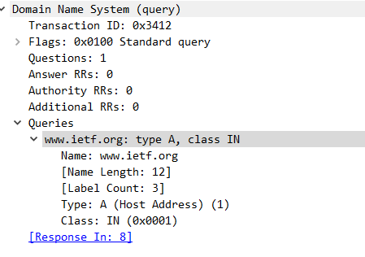
Lab 02-3: DNS
Type : A
Answer은 없다.

Slide 16
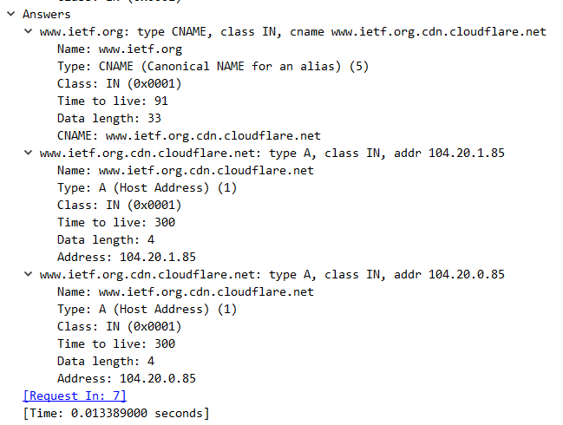
Lab 02-3: DNS
Name | Type | Class | Time to live | Data Length
www.ietf.org | CNAME | IN | 91 | 33 | CNAME : www.ietf.org.cdn.cloudflare.net
www.ietf.org.cdn.cloudflare.net | A | IN | 300 | 4 | Address : 104.20.1.85
www.ietf.org.cdn.cloudflare.net | A | IN | 300 | 4 | Address : 104.20.0.85

